Slide 1
Console stream class hierarchy
Managing console I/O operations
File stream class hierarchy
File Handling operations

Slide 2
Introduction
C++ provides a new technique for handling I/O operations through a mechanism known as streams.
A stream refers to a flow of data.
Classified in TWO categories:
Input stream
Output stream
In input stream the flow of data is from input device to a program in main memory.
In output stream flow of data is from program to the output device.

Slide 3
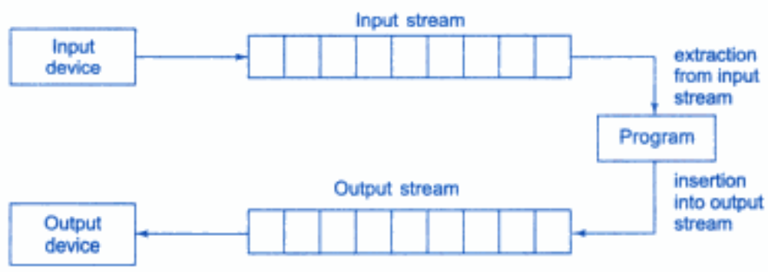
Data Streams
C++ provides several pre-defined streams that are automatically opened when the program begins its execution. These are cin and cout.
cin represents input stream connected to the standard input device (usually the keyboard) and cout represents output stream connected to the standard output device (usually the screen or VDU)
Here keyboard and screen are the default options, else redirection is possible to some other devices or files as per requirement.

Slide 4
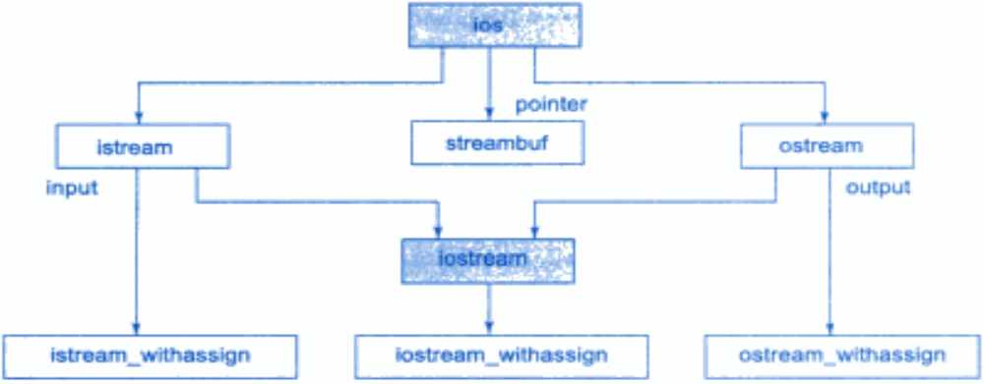
Console Stream Class Hierarchy
C++ I/O system contains a hierarchy of classes that are used to define various kinds of stream classes to deal with both the console and disk files.
These classes are called stream classes.

Slide 5
Stream Class Hierarchy
ios is the super class for istream (input stream) and ostream (output stream) which are, in turn, base classes for iostream (I/O stream).
The class ios is declared as the virtual base class so that only one copy of its members is inherited by the iostream.
ios provides the basic support for formatted and unformatted I/O operations.
The class istream provides the facilities for formatted and unformatted input while the class ostream provides the facilities for formatted output.
The class iostream provides the facilities for handling both input and output streams.
Three classes namely, istream_withassign, ostream_withassign & iostream_withassign add assignment operators to these classes.

Slide 6
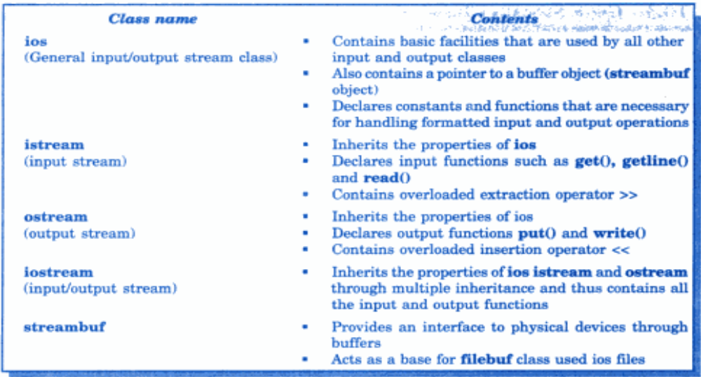
Stream Classes for Console Operations

Slide 7
Basic I/O Operations
Overloaded operators >> and <<
The objects cin and cout are used for input and output of different types of data.
This has been made possible by overloading the operators >> and << to recognize all the basic C++ types.
The >> operator is overloaded in the istream class and << is overloaded in the ostream class.
The general format:
cin>>var1>>var2>> … >>varn;
cout<<var1<<var2<< … <<varn;

Slide 8
get() and put() Functions
The classes istream and ostream define two member functions get() and put() respectively to handle the single character I/O operations.
There are two types of get() functions:
  get(char *) and get(void) prototypes to fetch a character including the blank space, tab and the newline character.
  The get(char *) version assigns the input character to its argument and the get(void) version returns the input character.
Since these functions are members of the I/O stream classes and must be invoked using an appropriate object.

Slide 9
Example for get(char *) function
Program that reads and displays a line of text
char ch;
cin.get(ch);
while(ch != ‘\n’)
{
cout<<ch;
cin.get(ch);
}

Slide 10
Example for get(void) function
Example: get(void) function,
char ch;
ch = cin.get();
while(ch != ‘\n’)
{
cout<<ch;
ch = cin.get();
}
Here the value returned by the function get() is assigned to the variable ch.

Slide 11
Example for put() function
The function put(), a member of ostream class, can be used to output a line of text char by char. For instance,
cout.put(‘w’);
cout.put(ch);
cout.put(66); // Displays the char B.
Example:
char ch;
cin.get(ch);
while(ch != ‘\n’)
{
cout.put(ch);
cin.get(ch);
}

Slide 12
File Handling – Introduction
Many real-life problems handle large volumes of data and in such situations we need to use some devices such as floppy disk/ hard disk to store the data.
The data is stored on these devices in the form of files.
A file is a collection of related data stored in a particular area on the disk.
Programs can be designed to perform read and write operations on these files.
A program typically involves either or both of the following kinds of data communication:
  Data transfer between the console unit and the program
  Data transfer between the program and a disk file.

Slide 13
Why to use Files?
Convenient way to deal large quantities of data.
Store data permanently (until file is deleted).
Avoid typing data into program multiple times.
Share data between programs.

Slide 14
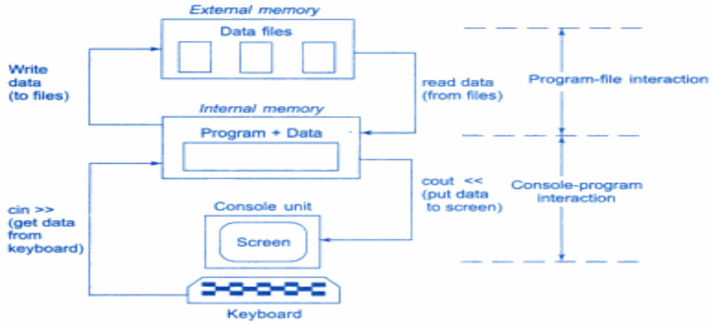
Console-Program-File Interaction

Slide 15
The fstream.h header file
Streams act as an interface between files and programs.
They represent as a sequence of bytes and deals with the flow of data.
Every stream is associated with a class having member functions and operations for a particular kind of data flow.
  File → Program read - Input stream
  Program → File write - Output stream
All designed into fstream.h and hence needs to be included in all file handling programs.

Slide 16
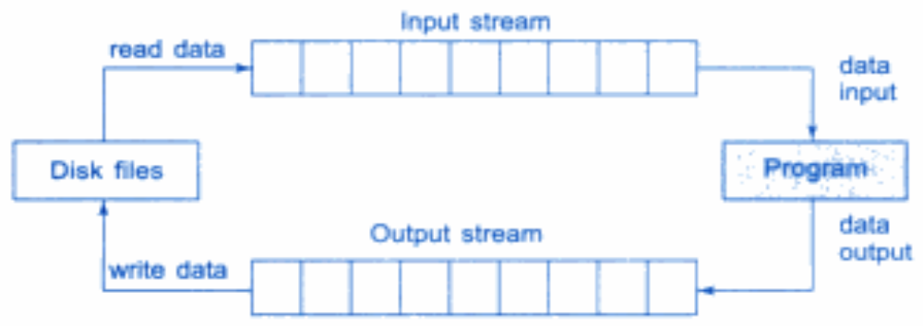
File Input/Output Streams

Slide 17
File Input/Output Streams
The I/O system of C++ handles file operations which are very much similar to the console I/O operations.
It uses file streams as an interface between the programs and the files.
The stream that supplies data to the program is known as input stream and the one that receives data from the program is known as output stream.
In other words, the input stream extracts (reads) data from the file and the output stream inserts (writes) data to the file.

Slide 18
Classes for File Stream Operations
The C++ I/O system contains a set of classes that define the file handling methods.
These include ifstream, ofstream and fstream.
These classes are derived from fstreambase and from the corresponding iostream class.
These classes (designed to manage the disk files) are declared in fstream and therefore, must be included in any program that uses files.

Slide 19
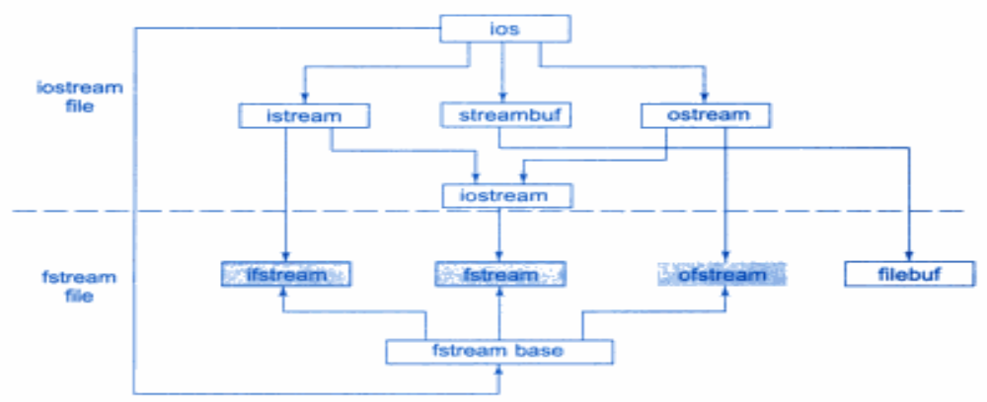
Stream Classes for File Operations

Slide 20
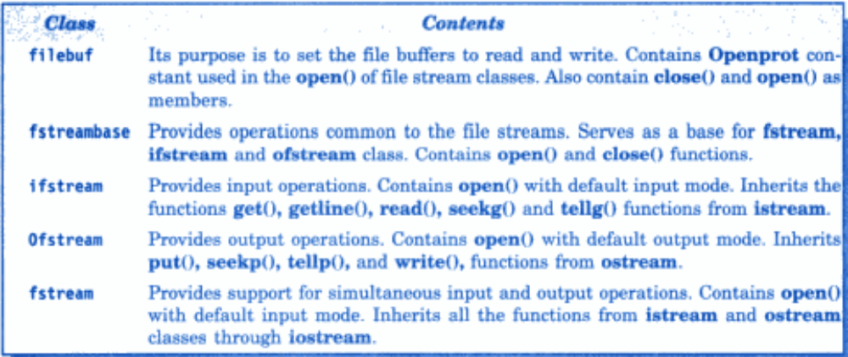
File Stream Classes

Slide 21
Opening a File
To perform I/O operations, we must open a file. So an object of appropriate file stream class must be created explicitly depending upon the type of operations one needs to perform on a file.
To perform write operations on a file, we need to create an object of ofstream class that manages output stream.
To perform read operations on a file, we need to create an object of ifstream class that manages input stream.
To perform both read and write operations on a file, we need to create an object of fstream class that manages both input and output streams.

Slide 22
Opening a File using open() function
We can open a file by using open() member function of the respective stream class which contain name of file as a parameter. Consider the following statements.
Ifstream inp_file;
Inp_file.open(“in.txt”);
Similarly the following statements
ofstream out_file;
out_file.open(“out.txt”);

Slide 23
Opening a File using Constructor
We can also open a file by using a constructor function of the respective stream class that takes the file name as parameter.
The following statement
Ifstream in_file(“in.txt”);
Creates an object in_file of ifstream class that connects the file name in.txt with the object in_file.
Similarly the statement
ofstream out_file(“out.txt”);
Creates an object out_file of ofstream class that connects the file name out.txt with the object out_file.

Slide 24
Method of opening a file using open() function is used when different files are to be connected with same file stream object at different times without recreating the object.
Consider the following statements
ofstream out1;
out1.open(“abc1.txt”);
out1.close();
out1.open(“abc2.txt”);
out1.close();
But if we had to perform same operation using constructors then we had to create separate objects for opening different files.

Slide 25
char str1[20],str2[20];
int x;
ifstream inf("Check.txt");
inf>>str1;
inf>>x;
inf>>str2;
inf.close();
cout<<" The name is "<<str1<<endl;
cout<<" The rollno is"<<x<<endl;
cout<<" The city is "<<str2<<endl;
return 0;
}
Program to open a file using Constructor function
#include<iostream>
#include<fstream>
using namespace std;
int main()
{
char name[20];
int rollno;
char city[20];
cout<<" Enter name, rollno and city"<<endl;
cin>>name>>rollno>>city;
ofstream outf("Check.txt");
outf<<name<<"\n";
outf<<rollno<<"\n";
outf<<city<<"\n";
outf.close();

Slide 26
Opening File using member function open()
The function open() can be used to open multiple files that uses the same stream object. This can be done as follows:-
file_stream_class stream_object;
stream_object.open(“ filename”);
Example 1
ofstream outf;
outf.open(“Result.txt”);
Example 2
ifstream inf;
inf.open(“Result1.txt”);
……………
…………..
inf.close();
inf.open(“Result2.txt”);
…………………..
…………………..
inf.close();

Slide 27
PROGRAM
int main()
{
ofstream outf;
outf.open("Country.txt");
outf<<"India"<<"\n";
outf<<"Mali"<<"\n";
outf<<"Somalia"<<"\n";
outf<<"Bhutan"<<"\n";
outf.close();
outf.open("Capital.txt");
outf<<"New Delhi"<<"\n";
outf<<"Bamako"<<"\n";
outf<<"Mogadishu"<<"\n";
outf<<"Thimphu"<<"\n";
outf.close();
ifstream inf;
inf.open("Country.txt");
cout<<"The contents of country file are"<<endl;
char str[50];
while(inf)
{
inf.getline(str,50);
cout<<str<<endl;
}
inf.close();
inf.open("Capital.txt");
cout<<"The contents of capital file are "<<endl;
while(inf)
{
inf.getline(str,50);
cout<<str<<endl;
}
inf.close();
}

Slide 28
PROGRAM TO READ FROM TWO FILES SIMULTANEOUSLY.
#include<iostream>
#include<fstream>
#include<stdlib.h>
using namespace std;
int main()
{
ifstream inf1, inf2;
inf1.open("Country.txt");
inf2.open("Capital.txt");
int i;
char str[50];
for(i=1;i<=10;i++)
{
if(inf1.eof()!=0)
{
cout<<" Exit from country file"<<endl;
exit(1);
}
if(inf2.eof()!=0)
{
cout<<" Exit from capital file"<<endl;
exit(1);
}
inf1.getline(str,50);
cout<<"The capital of "<<str<<endl;
inf2.getline(str,50);
cout<<str<<endl;
}
inf1.close();
inf2.close();
return 0;
}

Slide 29
Detecting End of File
Detection of end-of-file condition is necessary for preventing any further attempt to read data from file. This can be done using two ways-
while(fin)
Where fin is an object of ifstream class and it return zero when end of file is reached and non zero otherwise.
if( fin.eof() !=0 ) { exit(1); }
Where eof() is a member function of ios class. It returns a non zero value if end-of-file is reached and zero otherwise.

Slide 30

More about Open(): FILE MODES
The general syntax of open() function has two arguments:-
stream_object.open(“file name”,mode);
The first argument is the name of the file and second argument is the purpose of opening the file. The default values are
ios::in for ifstream functions meaning open for reading only
ios::out for ofstream functions meaning open for writing only

Slide 31
NOTE
Opening a file in ios::out mode also opens it in ios::trunc mode.
Both ios::app and ios::ate take us to the end of file when it is opened. The difference is that ios::app can add data to the end of file only whereas ios::ate can add data or modify the existing data anywhere in the file.
The fstream does not provide any mode by default, therefor mode must be provided explicitly by the user.
The ifstream class provide ios::in mode by default.
The ofstream class provide ios::out mode by default.

Slide 32


File Pointers and their manipulations
Each file has two associated pointers known as the file pointers.
get pointer (input pointer) – The input pointer is used for reading the contents of a given file location.
put pointer (output pointer) – The output pointer is used for writing the contents to a given file location.
DEFAULT ACTIONS
When we open as file in read only mode, the input pointer is automatically set at the beginning so that we can read the file from the start.
When we open as file in write only mode, the existing contents are deleted and the output pointer is set to the start of the file.

Slide 33

When we open the file in append mode, the output pointer will be set to the end of file so that data can be added to the existing file data.

Slide 34
Functions for manipulation of file pointers
1. seekg() - Move the get pointer to the specified location.
2. seekp() - Move the put pointer to the specified location.
3. tellg() - Gives the current position of get pointer.
4. tellp() - Gives the current position of put pointer.
seekg() and seekp() functions have two arguments:-
seekg(offset , refposition);
seekp(offset , refposition);
The parameter offset represents the number of bytes the file pointer is to be moved from the location specified by the parameter refposition. The refposition takes one of the following values:-
  ios::beg - Start of the file
  ` ios::cur - Current position of the file
  ios::end - End of the file

Slide 35
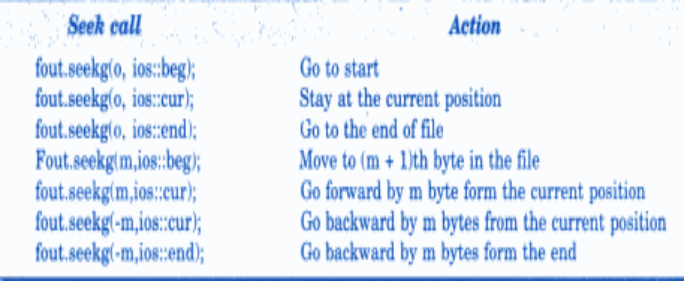

Slide 36
Sequential Input and Output Operations
There are two categories of these functions:-
Get() and put() function (for handling charcaters)
Read() and write() function( for handling blocks of binary data, mainly objects)
The get() function reads a single character from the input stream.
The put() functions writes a single character to the output stream

Slide 37
Program for get() and put() function
#include<iostream>
#include<fstream>
#include<string.h>
int main()
{
char str[50],ch;
cout<<" Enter a string"<<endl;
cin.getline(str,50);
int len = strlen(str);
fstream file;
file.open("Sample.txt",ios::in|ios::out);
for(int i=0;i<len;i++)
{
file.put(str[i]); //writing single character at time
}
file.seekg(0);
while(file)
{
file.get(ch);
cout<<ch;
}
file.close();
return 0;
}

Slide 38
Read() and write() function
These are binary input and output operations defined as follows:-
infile.read((char * & V , sizeof(V));
outfile.write((char * & V , sizeof(V));
The first argument is the address of the variable V, and that must be type cast to char *( i.e pointer to character type)
The second argument is the length of that variable in bytes.

Slide 39
Program for read() and write() function
#include<iostream>
#include<fstream>
#include<string.h>
using namespace std;
class student
{
int rollno;
char name[20],city[30];
public:
void getdata()
{
cout<<" Enter name, city and rollno"<<endl;
cin>>name>>city>>rollno;
}
void display()
{
cout<<"The name is "<<name<<endl;
cout<<"The city is "<<city<<endl;
cout<<"The rollno is "<<rollno<<endl;
}
};
int main()
{
student obj;
obj.getdata();
ofstream outf;
outf.open("Sample1.dat");
outf.write((char *)&obj, sizeof(obj)); // Writing into file
outf.close();
ifstream inf;
inf.open("Sample1.dat");
student obj1;
inf.read((char *)&obj1, sizeof(obj1)); //reading from file
obj1.display();
inf.close();
return 0;
}

Slide 40
Command line arguments
Command line arguments are specified in the main() function as follows:
int main(int argc , char *argv[ ])
The first argument is the argument counter(argc) that specifies the number of arguments in the command line.
The second argument argument vector(argv) is an array of char type pointers that points to the command line arguments.
Example:
C> result even.txt odd.txt
In this example the value of argc is 3 and argv will be an array of three pointers to strings as shown below-
argv[0] = result
argv[1] = even.txt
argv[2] = odd.txt
[NOTE: “result” will be the name of the program and in order to execute the program from command prompt, user should compile the program first.]

Slide 41
Program for Command line arguments
#include<iostream>
#include<fstream>
using namespace std;
int main(int argc, char *argv[])
{
int arr[ ]={11,22,33,44,55,66,77,88,99};
char ch;
ofstream outf1,outf2;
outf1.open(argv[1]);
outf2.open(argv[2]);
for(int i=0;i<8;i++)
{
if(arr[i]%2==0)
outf1<<arr[i]<<"\t";
else
outf2<<arr[i]<<"\t";
}
outf1.close();
outf2.close();
ifstream inf;
inf.open(argv[1]);
cout<<"The contents of even file are "<<endl;
while(inf)
{
inf.get(ch);
cout<<ch;
}
inf.close();
inf.open(argv[2]);
cout<<"\nThe contents of odd file are "<<endl;
while(inf)
{
inf.get(ch);
cout<<ch;
}
inf.close();
return 0;
}

Slide 42
int main(int argc, char * argv[])
{
if (argc!=2)
{
cout<<“wrong no of parameters”;
exit(0);
}
ifstream fin(argv[1]);
if(!fin)
{
cout<<“unable to open file”;
exit(0);
}
char ch;
while(fin.eof()==0)
{
fin.get(ch);
cout<<ch;
}
return 0;
}

Slide 43
c:\tcc>type1 abc.txt
it displays the contents of the file abc.txt
here argc=2, argv[0]=type1 argv[1]=abc.txt

